Slide 1
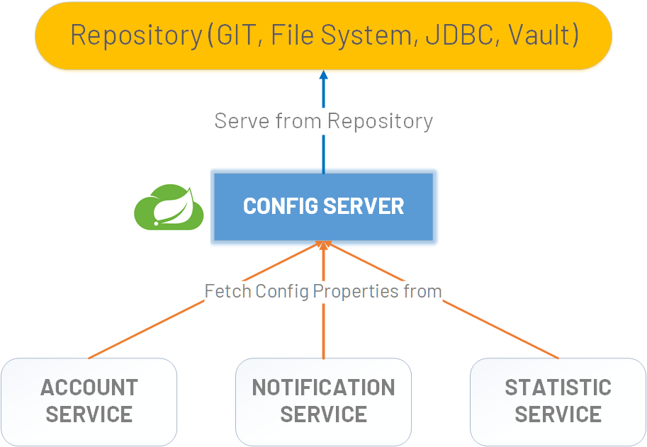

Spring Cloud Config Client
www.jmaster.io/course/microservices-with-spring-cloud

